Slide 1





INFOSYS SPRINGBOARD INTERNSHIP 2026
CLOUD SECURITY MONITORING SYSTEM
INCIDENT MANAGEMENT ASSISTANCE
Project Mentor: VIJAY VASANTH
Team: NIVETHA V · LAV SAXENA · DEEPALI SINGH · HRISHITHA DEY · VINAYKUMAR · RAKESH
☁ Slide 1 · OVERVIEW

Slide 2

WHY SERVER MONITORING MATTERS
Common operational failure modes in multi-server cloud deployments
MANUAL CLOUD OPERATIONS
OPERATIONAL IMPACT
SERVER SPRAWL & BLIND SPOTS
Hard to track missions without a single dashboard
NO ROLE ACCESS BOUNDARIES
Any users could accidentally delete critical servers.
SLOW MANUAL INSPECTIONS
Missed sudden CPU surge and RAM exhaustion.
NOTIFICATION NOISE & FATIGUE
Alert spam causes teams to ignore real outages.
MISSED EMERGENCIES
Without fast SMS, teams discover crashes too late
UNEXPECTED NODE CRASHES
Workloads crash production servers without warning.
☁ Slide 2 · THE PROBLEM

Slide 3


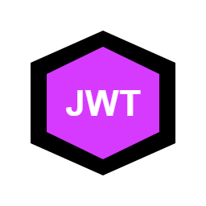
WHAT WE SET OUT TO BUILD
6 core capabilities engineered for automated cloud security monitoring
ONE LIVE DASHBOARD
Single pane view for CPU, memory, & disk
60-SECOND AUTO CHECKS
Scheduled background health polling daemon
ROLE-BASED PERMISSIONS
Admin full control vs Viewer read-only
MULTI-CHANNEL ALERTS
Critical Twilio SMS & warning SMTP emails
DUPLICATE SUPPRESSION
Prevents repeated OPEN alerts for same asset
DUAL-TOKEN AUTHENTICATION
15-min access & 7-day refresh JWT tokens
☁ Slide 3 · PROJECT GOALS

Slide 4







TECH STACK — LAYERED VIEW
Selected technologies with clean separation across tiers
FRONTEND
BACKEND
DATA LAYER
SECURITY & OPS
React 18
Java 21
PostgreSQL
Spring Security
Vite Engine
Spring Boot 4
Redis Cache
JWT Stateless
Axios Client
Spring Data JPA
Tomcat Server
Twilio SMS
CSS Visuals
Apache Maven
Git Versioning
SMTP Email
☁ Slide 4 · TECH STACK

Slide 5
ARCHITECTURE & MODULAR SERVICES
End-to-end request flow User → React → Spring Boot → DB, and core decoupled services
END-TO-END SYSTEM FLOW
CORE REST ENDPOINTS
1. USER OPERATOR
Browser client (Admin or Viewer role)
/api/auth · JWT login & refresh
/api/assets · Server vitals CRUD
2. REACT 18
Single page interface with Axios JWT interceptor
/api/alerts · Incident lifecycle
/api/users · Roles & accounts
3. SPRING BOOT REST
REST controllers routing endpoints & validation
CORE BACKEND SERVICES
Auth & RBAC Service
Dual JWT generation & role verification
4. SPRING SECURITY
JwtAuthFilter validates HMAC & enforces RBAC
Asset Telemetry Service
CRUD operations & live health statistics
5. SERVICE & DAEMON
Core logic & 60-second background health scanner
Health Monitor Daemon
60-second fixed-rate polling engine
Alert & Incident Service
Threshold rules & OPEN ➔ RESOLVED lifecycle
6. POSTGRESQL DB
Spring Data JPA parameterized queries & Hibernate
Twilio & Mail Notifications
Direct mobile SMS & SMTP email alerts
☁ Slide 5 · ARCHITECTURE & SERVICES

Slide 6
DATABASE SCHEMA & ENTITY RELATIONS
Normalized PostgreSQL relational schema and integrity rules
infrastructure_assets (Servers)
• id (BIGINT PRIMARY KEY)
• asset_name (UNIQUE Hostname)
• cpu, memory, disk (% metrics)
• asset_status (ONLINE / WARNING / CRITICAL)
alerts (Incident Tickets)
• id (BIGINT PRIMARY KEY)
• asset_id (FOREIGN KEY -> assets)
• severity (LOW, MEDIUM, HIGH, CRITICAL)
• status (OPEN or RESOLVED)
users & roles (Security)
• users: username, BCrypt password, active
• roles: ROLE_ADMIN, ROLE_VIEWER
• user_roles: Many-to-many bridge table
Relational Integrity Rules
• One-to-Many: One server links to multiple alerts
• Many-to-Many: Users bridge to system roles
• Parameterized JPA queries prevent SQL injection
☁ Slide 6 · DATABASE

Slide 7
HOW THE REACT FRONTEND WORKS
Client-side state architecture, interceptors, and telemetry UI
FAST REACT 18
Component-based UI loading fast without page reloads
SHARED AUTH CONTEXT
Remembers Admin vs Viewer permissions across all views
AUTOMATIC TOKEN INTERCEPTOR
Attaches Bearer access token to every outgoing API call
SILENT TOKEN REFRESH
Seamlessly acquires fresh access token before expiration
DASHBOARD
Styled cards, responsive tables, and visual alert chips
LIVE VISUAL METERS
Display RAM, CPU, and server health through cards and visual elements
☁ Slide 7 · FRONTEND

Slide 8
CORE REST API SPECIFICATION
Exactly one GET, one POST, and one DELETE endpoint contract (Mentor Requirement)
GET
/api/assets [Logged In Users]
Retrieves list of all monitored servers & live health metrics
Payload / Response: -> [ { id: 1, assetName: 'Web-01', cpuUsage: 45 } ]
POST
/api/assets [Admin Only]
Registers and provisions a new infrastructure asset
Payload / Response: { assetName: 'DB-02', assetType: 'SERVER' } -> Saved (HTTP 201)
DELETE
/api/assets/{id} [Admin Only]
Decommissions and permanently deletes an asset by ID
Payload / Response: Path: id=5 -> HTTP 204 No Content (Deleted)
☁ Slide 8 · REST APIS

Slide 9
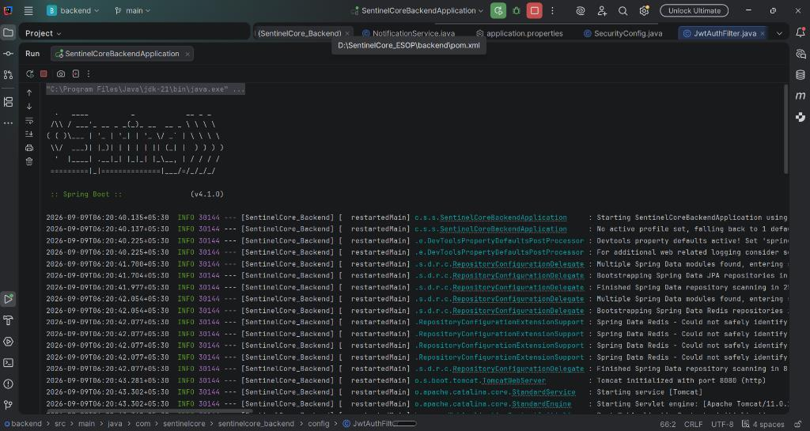
MILESTONE 1 — INITIAL SETUP & FOUNDATION
Starting Spring Boot 4, PostgreSQL, and React 18 frontend
Java 21 & Spring Boot 4
Configured backend environment
PostgreSQL Database
Connected with Tomcat connection pool
Organized Architecture
Separated controllers, services & repos
Server Entity Schema
Table created to store server vitals
React 18 & Vite Frontend
Fast development & build environment
Terminal — Spring Boot 4.1.0 & Tomcat (Port 8080)
✓ Verified: Backend and PostgreSQL pool initialized cleanly
☁ Slide 9 · MILESTONE 1

Slide 10
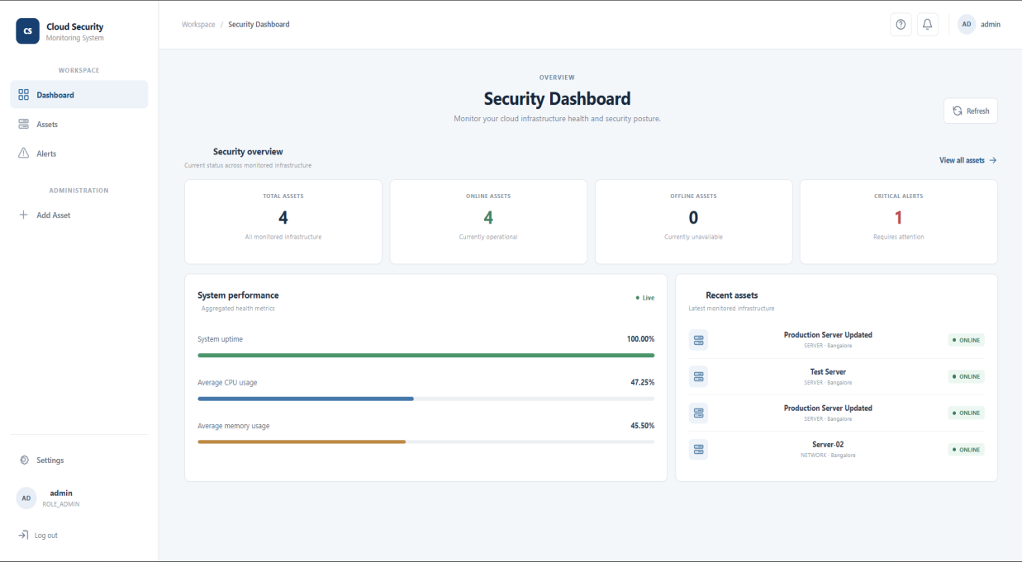
MILESTONE 2 — SERVER MANAGEMENT & DASHBOARD
Server CRUD APIs and live React monitoring dashboard
Server CRUD REST APIs
Endpoints to add, view, update & delete
Fast Summary Endpoint
Returns total, online, & warning counts
Clean Java Builders
Used Lombok builder & safe null checks
Live React Dashboard
Real-time cards show cluster health
Add Server Dialog
Modal popup form to register new servers
Chrome — Cloud Security Monitoring Dashboard (Port 5173)
✓ Verified: Live dashboard tracks 4 assets with 100% uptime
☁ Slide 10 · MILESTONE 2

Slide 11
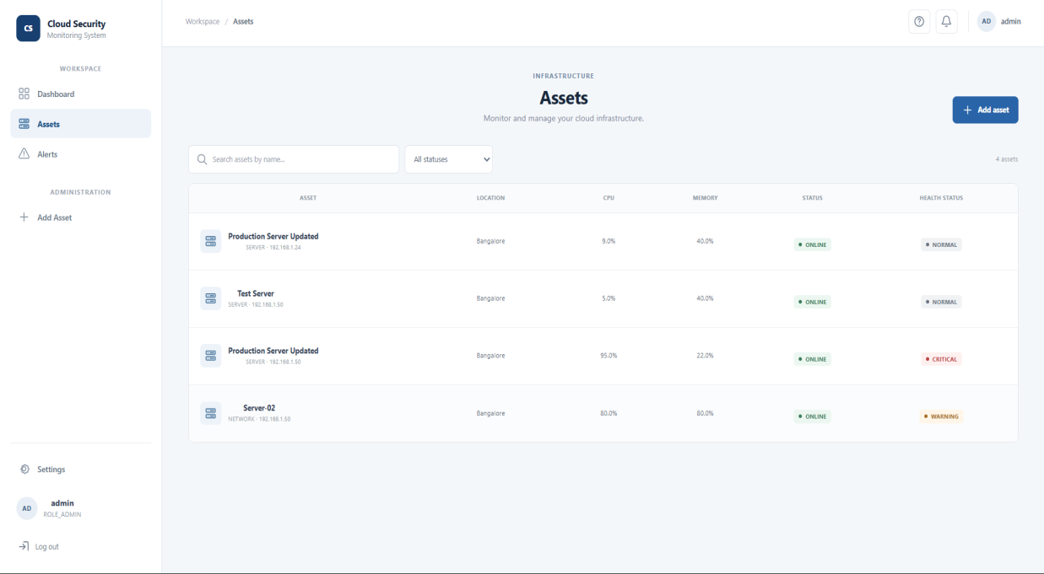
MILESTONE 3 — AUTOMATIC HEALTH CHECKS & ALERTS
60-second telemetry scan, threshold classification, and incident lifecycle
1. 60-Second Background Scan
Checks CPU, memory, & ping for all servers every minute
2. Metric Threshold Evaluation
≥90% CRITICAL · ≥80% WARNING · <80% NORMAL
3. Create Incident Record
Persists open incident ticket in PostgreSQL linked to server
4. Multi-Channel Dispatch
Twilio SMS for critical alerts · SMTP email for warnings
Alert Lifecycle: OPEN ➔ RESOLVED
Two-state tracking; allows admin to mark issue as fixed in UI
Dashboard — Current Assets & Automated Critical Incident
✓ Verified: Incident lifecycle (OPEN ➔ RESOLVED) verified
☁ Slide 11 · MILESTONE 3

Slide 12
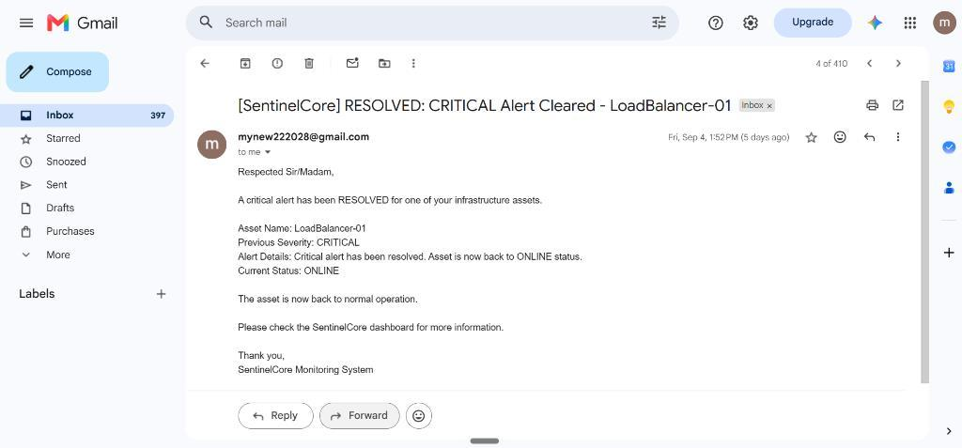
MILESTONE 4 — LOGIN ROLES & MULTI-CHANNEL ALERTS
Dual-token login, Admin vs Viewer permissions, and alerts
Dual-Token Login
15-min access token and 7-day refresh token
Admin vs Viewer Roles
Admins have edit controls; Viewers read-only
Backend Role Enforcement
Server stops Viewers calling write endpoints
Twilio Alert Dispatch Sequence
Critical Spike (≥90%) ➔ Backend Service ➔ Twilio API ➔ Mobile SMS
Duplicate Alert Prevention
Suppresses repeated OPEN alerts for same asset
Gmail — Automated Incident Alert Delivered [SMTP]
✓ Verified: Out-of-band email notification delivered to admin
☁ Slide 12 · MILESTONE 4

Slide 13
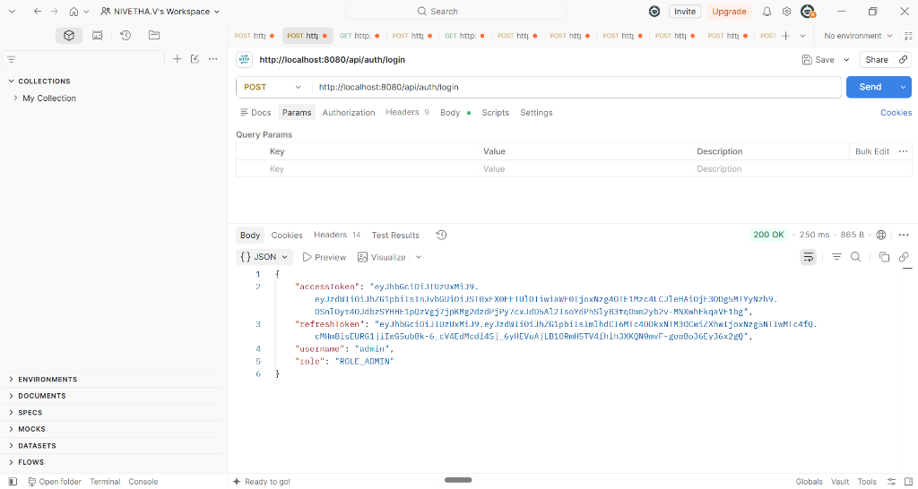

POSTMAN TESTING EVIDENCE & ROLE VERIFICATION
Real API tests showing status codes, dual tokens, and role restrictions
Status 200 OK Confirmed
Correct requests return clean JSON data
Status 401 Block Confirmed
Rejects requests without login tokens
Token Refresh Confirmed
Refresh token generates new access token
ROLE_VIEWER ➔ 403 Forbidden
Proves Viewers cannot delete or add servers
ROLE_ADMIN ➔ 200 OK / 204
Full administrative control verified
Postman — POST /api/auth/login [Status: 200 OK]
✓ Verified: Dual JWT tokens & RBAC permissions proven
☁ Slide 13 · TESTING PROOF

Slide 14
SECURITY & CHALLENGES SOLVED
Production hardening, credential isolation, and engineering fixes
SCRAMBLED PASSWORDS
Hashed with BCrypt so never stored in plain text
DOUBLE REFRESH QUEUING
Queued Axios calls prevent duplicate concurrent token refresh requests
SECURE SECRET STORAGE
Twilio API credentials and SMTP mail passwords isolated in config
SAFE DATABASE QUERIES
Spring Data JPA uses parameterized queries, reducing SQL injection risks
SAFE ERROR MASKING
Central exception handler masks internal database details and SQL errors
DUPLICATE ALERT PREVENTION
Suppresses repeated OPEN alerts for same asset to prevent alert fatigue
☁ Slide 14 · SECURITY & CHALLENGES

Slide 15






CLOUD DEPLOYMENT & FUTURE SCOPE
AWS production deployment architecture and roadmap for platform expansion
AWS CLOUD PRODUCTION DEPLOYMENT
PRACTICAL FUTURE SCOPE
DOCKER CONTAINERIZATION
Spring Boot backend & React packaged as Docker images
CUSTOM SERVER THRESHOLDS
Allow admins to set custom CPU & RAM limits per server from UI
AWS EC2 COMPUTE CLOUD
Linux microservice container running on port 8080
HISTORICAL METRIC TRENDS
Store 24-hour telemetry to render hourly CPU usage charts
MANAGED AWS RDS DATABASE
PostgreSQL engine with multi-AZ backups & ACID safety
INCIDENT REPORT EXPORTS
One-click export of resolved alerts and uptime logs to CSV/PDF
AWS CLOUDWATCH METRICS
Infrastructure CPU, memory, & network monitoring
DISCORD & TELEGRAM ALERTS
Simple team webhook triggers for group channel notifications
☁ Slide 15 · CLOUD DEPLOYMENT & FUTURE SCOPE

Slide 16
PROJECT SUMMARY & KEY HIGHLIGHTS
All four milestones completed, validated, and hardened for cloud deployment
ALL 4 MILESTONES DELIVERED
Successfully built, integrated, and validated every assigned feature
RELIABLE 60s SERVER CHECKS
Automatic background daemon spots high CPU, memory, and ping issues
FAST VISUAL DASHBOARD
Real-time metric progress bars and status cards give instant cluster health
REAL ROLE-BASED SECURITY
Admins have full edit access while Viewers only have read permissions
FAST PHONE SMS ALERTS
Twilio mobile SMS and SMTP email ensure emergencies are never missed
PROVEN WITH AUTOMATED TESTS
Postman tests confirm REST API contracts and RBAC boundaries
☁ Slide 16 · SUMMARY & HIGHLIGHTS

Slide 17
THANK YOU!
Cloud Security Monitoring System with
Incident Management Assistance
Project Mentor: VIJAY VASANTH
Open for Questions & Technical Discussion
☁ Slide 17 · THANK YOU

